Slide 1
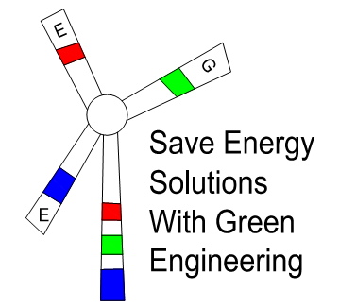
Reliable, safe, Green and convenient.
The only long-term
backup power solution
To learn more our products, Please contact our agent:
綠源工程顧問有限公司
Green Energy Engineering Consultancy Limited
綠源工程（遠東）有限公司
Companhia De Engenharia Green Energy (Far East) Limiteda
Tel: 3421-0208 Fax: 3186-2513
E-mail: info@greenpower-e.com Website: www.greenpower-e.com
Address: 6/F., Kong Ling Bldg., 102 Jervois St., Sheung Wan, HK.

Slide 2
1 About Us
Aqueous Hydrogen Energy Limited (AHE)
A Hong Kong based high-tech hydrogen energy and fuel cell technology enterprise, specializing in the research and
development and manufacturing of hydrogen generator and fuel
cell system.
We focus on the R&D, production and sales of electric power products in the field of clean energy in an all-round way. Including Telecom backup power, industrial power, Vehicle power, household consumption and so on.
2

Slide 3
؍ᇶ Confidential 3

Slide 4
2 Products
S Series Hydrogen Generator
Output >99.95% H₂
Flow Rate 35~110 slm
be used for a 1-10kW fuel cell system

Slide 5
2 Products
AHG Series Communication Aqueous Hydrogen Power Generator
Fuel:Methanol water
Power Output:2.5-5kW 48VDC
No Pollution Environmentally friendly
Outdoor design cabinet (IP54)

Slide 6
Product contrast
AHE-New Energy Leader
High Cost
Solar and Wind Power
Hydrogen Fuel Cell System
Unstable Discontinuous
Stable Reliable
Large-scale mass production
Gasoline
Generator
AHG
Battery
Low Cost

Slide 7
Why choose us in telecom bachup ?
Parameters AHG Gasoline Generator¹
Cost | Fuel | Methanol Water Gasoline
 | CAPEX | $4,000/kW | $200/kW
 | OPEX | $0.30/kWh | $0.45/kWh
Usage | Lifetime | >10years | 2 years
 | Continuous service life | >5,000 h | <200 h
 | Use environment | Field and Outdoor + Indoor | Unable to prevent rain
Environmental test | Solid pollution | Recyclable | Scrap parts and steel
 | Noise pollution | <30dB (7m) | 70dB (7m)
 | Emission CO₂ | 783 g/kWh | 1500.0 g/kWh
 | Emission CO | 0 g/kWh | 8.0 g/kWh
 | Emission NOx | 0 g/kWh | 7.5 g/kWh
 | Emission SOx | 0 g/kWh | 12.0 g/kWh
 | PM 2.5 | 0 g/kWh | 0.8 g/kWh
1 EPA standard of performance for stationary compression ignition intimal combustion engines: Final Rule July 11, 2006

Slide 8
Product contrast
Noisy
Pollution
Unable to worh continuously for long hours
Optimal choice of Typhoon & bad weather
power Backup
Gasoline Generator
Quiet
Reliable
Green
Worh Never Stop for 5666h
Aqueous Hydrogen Power Generator

